Slide 1
Chapter 1
Scientific Measurements
Chemistry: The Molecular Nature of Matter, 7E
Jespersen/Hyslop

Slide 2
Chapter in context
Classification of Matter
Physical and Chemical properties of Matter
Measurement
Handling Numbers
Dimensional Analysis

Slide 3
Matter and Its Classifications
Matter
  Anything that has mass and occupies space
Matter can be classified in two ways
By state
By composition

Slide 4
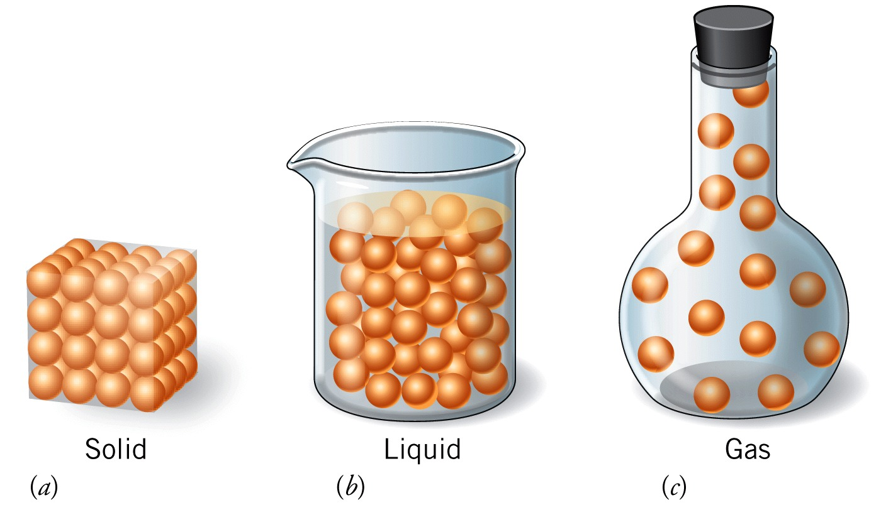
States of Matter
Solids:
Fixed shape and volume
Particles are close together
restricted motion
Liquids:
  Fixed volume, but take container shape
  Particles close together
  able to flow
Gases:
  No fixed shape and volume
  Expand to fill entire container
  Particles separated by lots of space
4

Slide 5
Matter by composition
Pure substances
  Elements and compounds
  Composition always same regardless of source
Mixture
  Can have variable compositions
  Made up of two or more substances
  Two broad categories of mixtures:
    Heterogeneous
    Homogeneous

Slide 6
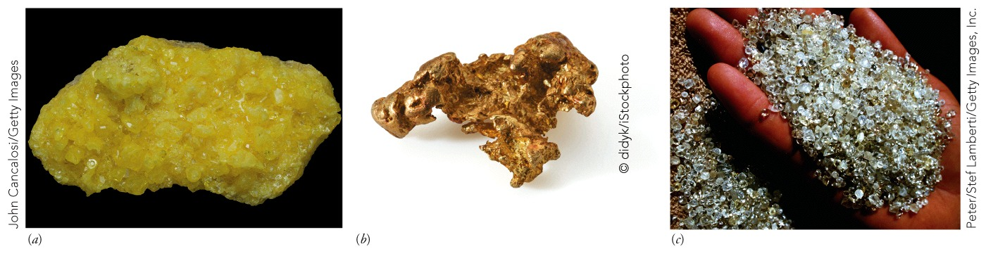
Elements
Substances that can’t be decomposed into simpler materials by chemical reactions
Substances composed of only one type of atom
Sulfur
Gold
Carbon (diamond)

Slide 7
Chemical Symbols for Elements
  One or two letter symbol for each element name
  First letter capitalized, second letter lower case
    e.g., C = carbon S = sulfur
    Ca = calcium Ar = argon
    Br = bromine H = hydrogen
    Cl = chlorine O = oxygen
  Most based on English name
  Some based on Latin or German names

Slide 8
Chemical Symbols Examples
English Name | Chemical Symbol | Latin Name
Sodium | Na | Natrium
Potassium | K | Kalium
Iron | Fe | Ferrum
Copper | Cu | Cuprum
Silver | Ag | Argentum
Gold | Au | Aurum
Mercury | Hg | Hydrargyrum
Antimony | Sb | Stibium
Tin | Sn | Stannum
Lead | Pb | Plumbum
Tungsten | W | Wolfram (German)

Slide 9
Compounds
Formed from two or more atoms of different elements
Always combined in same fixed ratios by mass
Can be broken down into elements by some chemical changes
e.g., Water decomposed to elemental hydrogen and oxygen

Slide 10
Homogeneous Mixtures
Same properties throughout sample and single
phase
Homogeneous mixtures also known as solution
  Liquid solution
    Sugar in water
    Coca-Cola (without ice)
  Gas solution
    Air
      Contains nitrogen, oxygen and other gases
  Solid solution
    US 5¢ coin – Metal alloy
      Contains copper and nickel metals

Slide 11
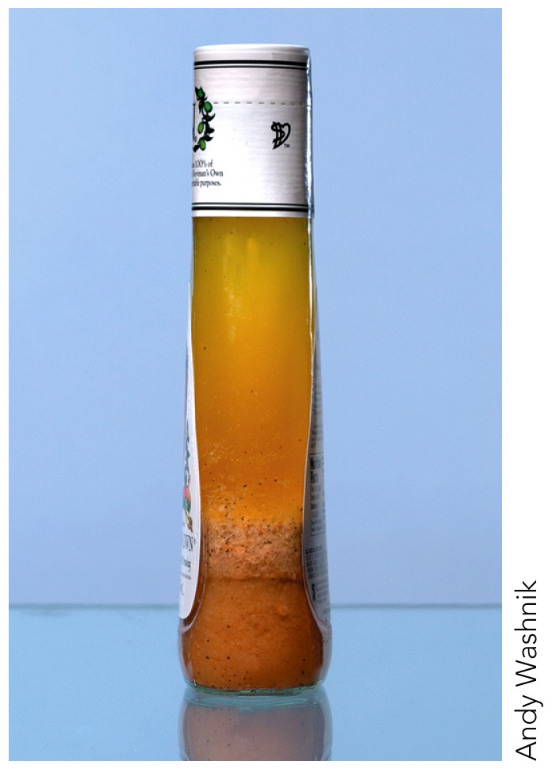
Heterogeneous Mixtures
Two or more regions of different properties
Solution with multiple phases
Separate layers
e.g.,
  Salad dressing
    Oil and vinegar
  Ice and water
    Same composition
    Two different physical states

Slide 12
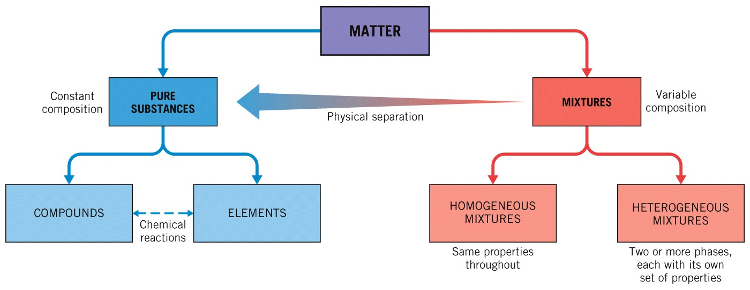
Relationship of Elements, Compounds, and Substances

Slide 13
Learning Check: Classification
 | Chicken Noodle Soup | Ice (H₂O) | Liquid Dish Soap | Table Salt (NaCl)
Pure substance
Element
Compound
Heterogeneous Mixture
Homogeneous Mixture
X
X
X
X
X
X

Slide 14
Your Turn!
Coffee is a homogeneous mixture. When you add sugar to it and the sugar dissolves…
  the coffee becomes a heterogeneous mixture.
  the coffee is still a homogeneous mixture.
  the coffee, which used to be a pure compound, is no longer a pure compound.
  the coffee, which used to be an element, is no longer an element.
  the sugar reacts with water to form a new compound.
14

Slide 15
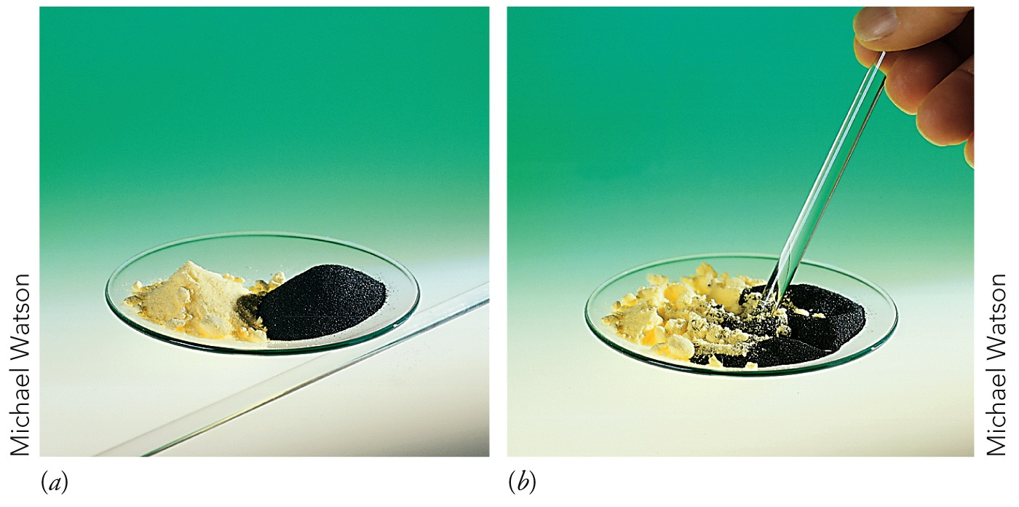
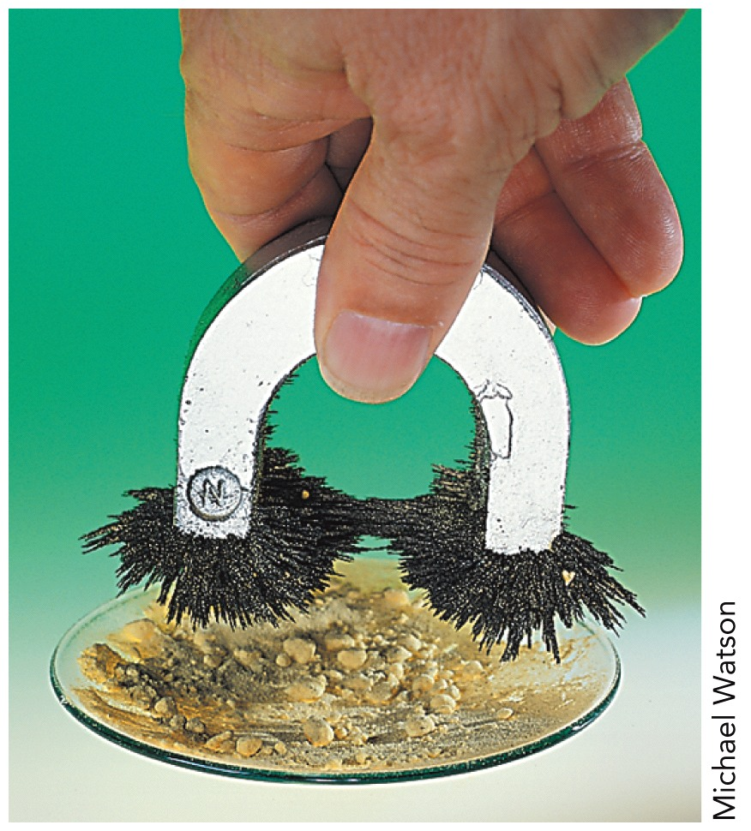
Physical Change
No new substances formed
Substance may change state or the proportions
e.g., Ice melting (change in state)
Sugar or salt dissolving
Stirring iron filings and sulfur together

Slide 16
Chemical Change
  Formation of new substance or compound
  New substance has different physical properties
e.g.,
Burning a piece of paper to ash

Slide 17
Learning Check:
For each of the following, determine if it represents a chemical or physical change:
 | Chemical | Physical
Magnesium burns when heated
Magnesium metal tarnishes in air
Magnesium metal melts at 922 K
Grape Kool-Aid lightens when water is added
X
X
X
X

Slide 18
Your Turn!
Which one of the following represents a physical change?
when treated with bleach, some dyed fabrics change color
grape juice left in an open unrefrigerated container turns sour
when heated strongly, sugar turns dark brown
D. in cold weather, water condenses on the inside surface of single pane windows
E. when ignited with a match in open air, paper burns
18

Slide 19
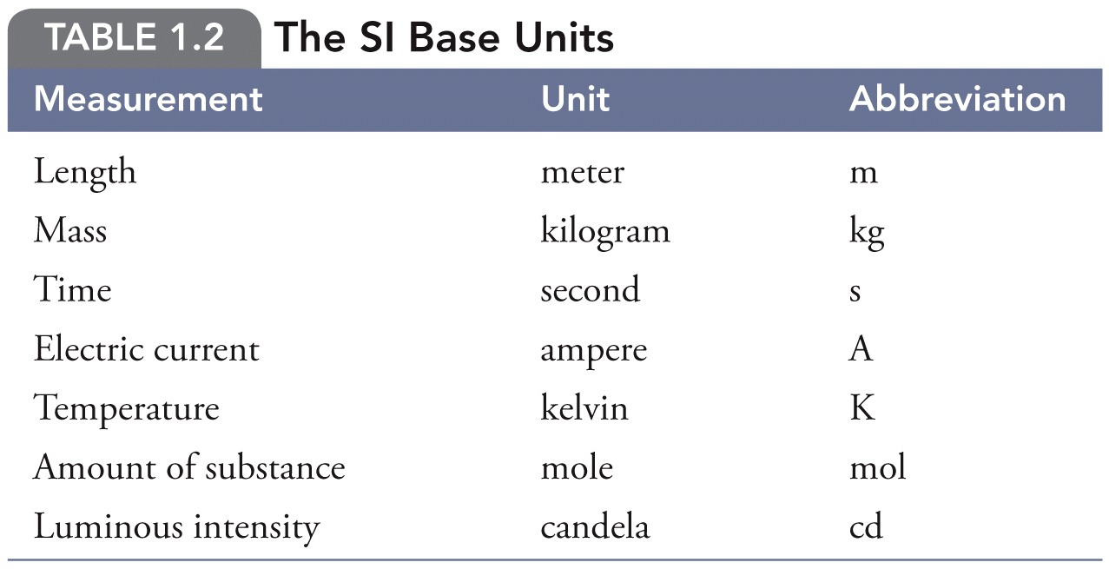
International System of Units (SI)
Standard system of units used in scientific and engineering measurements
Metric ▪ Seven Base Units
19
Notes:
19

Slide 20
Your Turn!
The SI unit of length is the
  millimeter
  meter
  yard
  centimeter
  foot
20

Slide 21
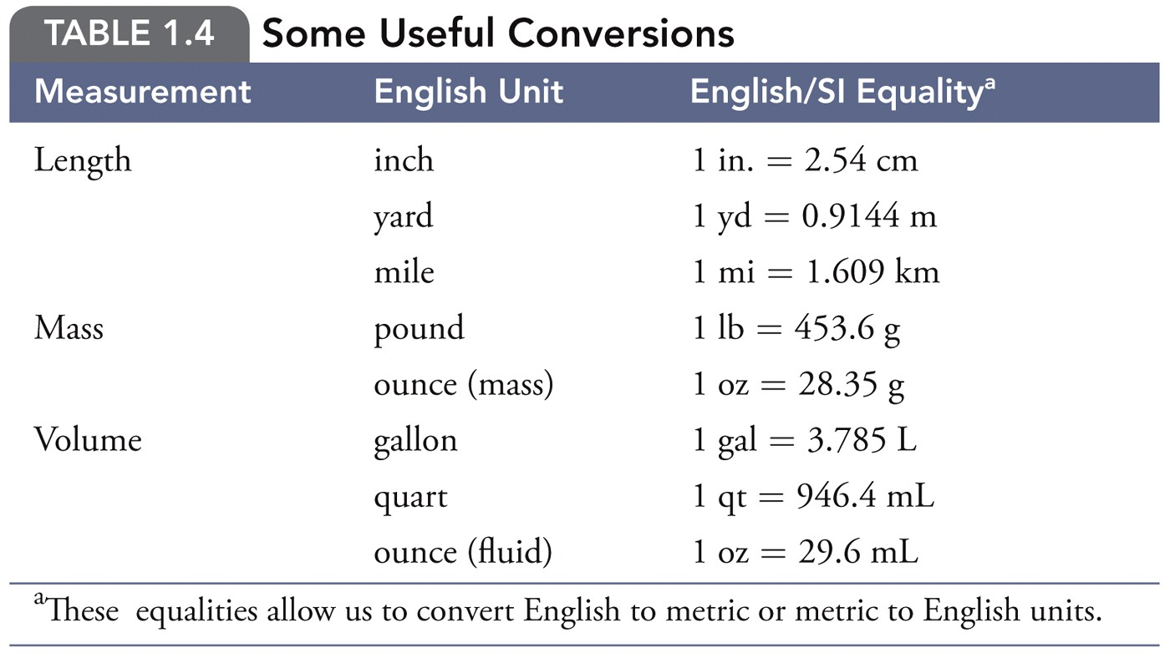
Some Useful Conversions
21
Notes:
21

Slide 22
Using Decimal Multipliers
Use prefixes on SI base units when number is too large or too small for convenient usage
Numerical values of multipliers can be interchanged with prefixes
  Example: 1 mL = 10^{–3} L
  1 km = 1000 m
  1 ng = 10^{–9} g
  1,130,000 m = 1.13 × 10⁶ m = 1.13 Mm
22

Slide 23
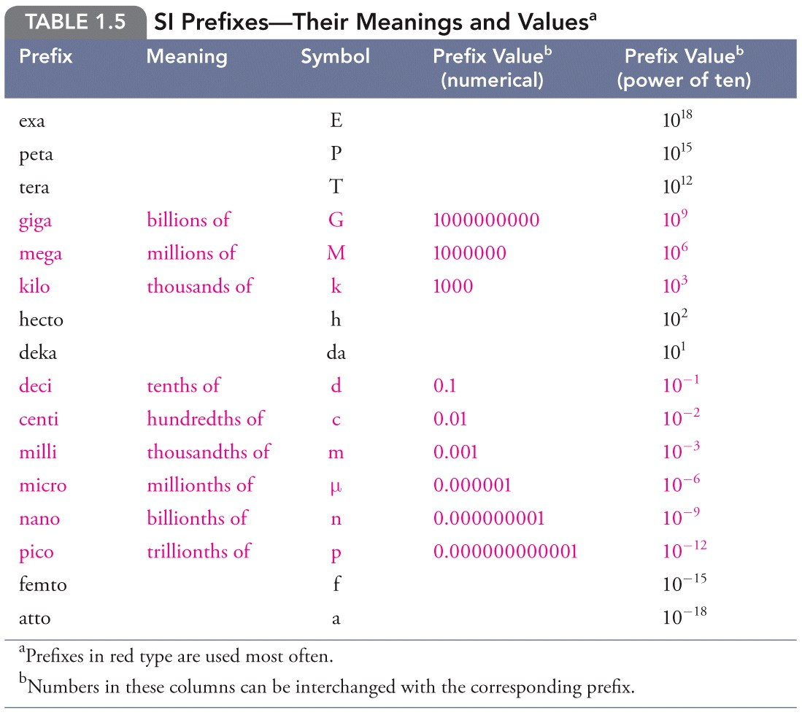
Decimal Multipliers
23
Notes:
23

Slide 24
Laboratory Measurements
  Length
  Volume
  Mass
  Temperature
24

Slide 25
Laboratory Measurements
Length
  SI Unit is meter (m)
  Meter too large for most laboratory measurements
  Commonly use
    Centimeter (cm)
      1 cm = 10^{–2} m = 0.01 m
    Millimeter (mm)
      1 mm = 10^{–3} m = 0.001 m
25
Notes:
25

Slide 26
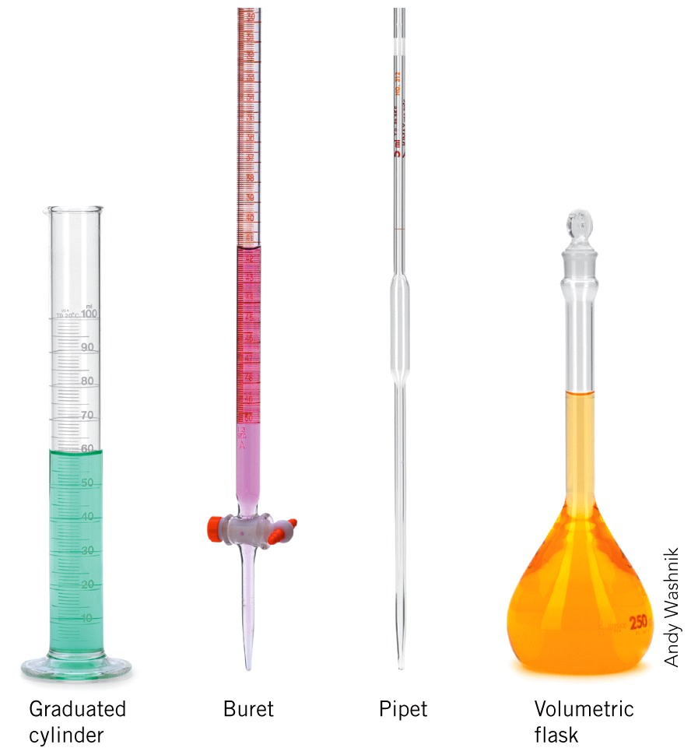
2. Volume
Dimensions of (length)³
SI unit for Volume = m³
Chemistry glassware marked in L or mL
  1 L = 1000 mL
What is a mL?
  1 mL = 1 cm³
26

Slide 27
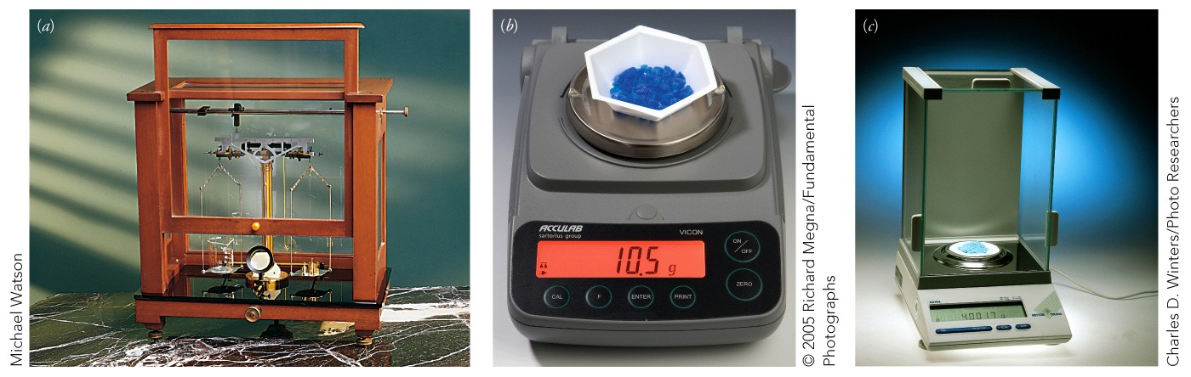
3. Mass
SI unit is kilogram (kg)
  Frequently use grams (g) in laboratory as more realistic size
1 kg = 1000 g 1 g = 0.1000 kg = kg
Instrument used = balance
27

Slide 28
4. Temperature
Measured with thermometer
Three common scales
Fahrenheit scale
Most common use in USA (˚F)
B. Celsius scale
Most common for use in science (˚C)
C. Kelvin scale
SI unit of temperature is kelvin (K)
Absolute Zero, Zero point on Kelvin scale @ nature’s lowest
possible temperature
28

Slide 29
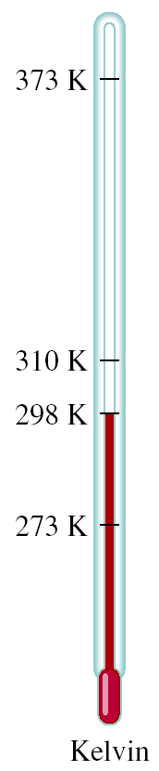
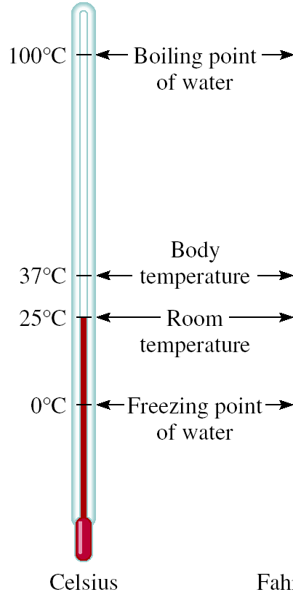
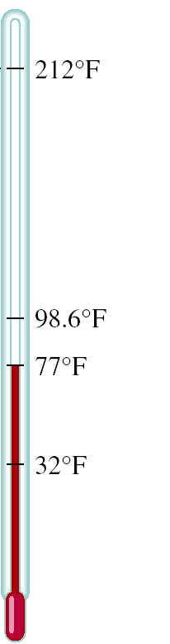


Temperature Scale
K = ⁰C + 273.15
273.15 K = 0 ⁰C
373.15 K = 100 ⁰C
9
⁰F = x ⁰C + 32
5
32 ⁰F = 0 ⁰C
212 ⁰F = 100 ⁰C

Slide 30
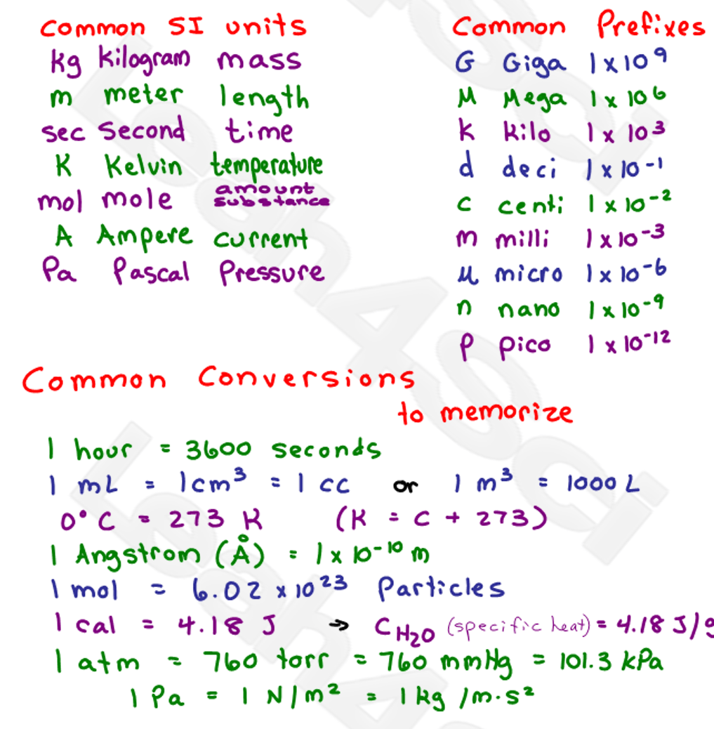

Slide 31
Significant Figures
Scientific convention:
  All digits in measurement up to and including first estimated digit are significant.
Number of certain digits plus first
uncertain digit
31

Slide 32
Rules for Significant Figures
All non-zero numbers are significant.
  e.g., 3.456 has 4 sig. figs.
Zeros between non-zero numbers
are significant.
  e.g., 20,089 or 2.0089 × 10⁴ has 5 sig. figs
Trailing zeros always count as significant if number has decimal point
  e.g., 500. or 5.00 × 10² has 3 sig. figs
32
Notes:
32

Slide 33
Rules for Significant Figures
Final zeros on number without decimal point are NOT significant
  e.g., 104,956,000 or 1.04956 × 10⁸
  has 6 sig. figs.
Final zeros to right of decimal point are significant
  e.g., 3.00 has 3 sig. figs.
Leading zeros, to left of first nonzero digit, are never counted as significant
    e.g., 0.00012 or 1.2 × 10^{–4} has 2 sig. figs.
33

Slide 34
Learning Check
How many significant figures does each of the following numbers have?
Scientific Notation # of Sig. Figs.
413.97
0.0006
5.120063
161,000
3600.
4.1397 × 10²
5
6 × 10^{–4}
1
5.120063
7
1.61 × 10⁵
3
3.600 × 10³
4
34

Slide 35
Your Turn!
How many significant figures are in 0.0005650850?
  7
  8
  9
  10
  11
Could be rewritten as 5.650850 × 10⁻⁴
35

Slide 36
Significant Figures in Calculations
Multiplication and Division
Number of significant figures in answer = number of significant figures in least precise measurement
e.g., 10.54 × 31.4 × 16.987
4 sig. figs. × 3 sig. figs. × 5 sig. figs. = 3 sig. figs.
e.g., 5.896 ÷ 0.008
  4 sig. figs. ÷ 1 sig. fig. = 1 sig. fig.
= 5620 = 5.62×10³
= 700 = 7×10²
36

Slide 37
Your Turn!
Give the value of the following calculation to the correct number of significant figures.
1.21213
1.212
1.212132774
1.2
1
37

Slide 38
Significant Figures in Calculations
Addition and Subtraction
Answer has same number of decimal places as quantity with fewest number of decimal places.
e.g.,
e.g.,
12.9753
319.5
+ 4.398
4 decimal places
1 decimal place
3 decimal places
1 decimal place
336.9
397
– 273.15
0 decimal places
2 decimal places
0 decimal place
124
38

Slide 39
Learning Check
For each calculation, give the answer to the correct number of significant figures.
10.0 g + 1.03 g + 0.243 g =
19.556 °C – 19.552 °C =
327.5 m × 4.52 m =
15.985 g ÷ 24.12 mL =
11.3 g or
1.13 × 10¹ g
0.004 °C or
4 × 10^{–3} °C
1.48 × 10³ m
0.6627 g/mL or
6.627 × 10^{–1} g/mL
39

Slide 40
Your Turn!
When the expression,
412.272 + 0.00031 – 1.00797 + 0.000024 + 12.8
is evaluated, the result should be expressed as:
424.06
424.064364
424.1
424.064
424
40

Slide 41
Scientific Notation
568.762
0.00000772
move decimal left
move decimal right
n > 0
n < 0
568.762 = 5.68762 x 10²
0.00000772 = 7.72 x 10⁻⁶
Addition or Subtraction
Write each quantity with the same exponent n
Combine N₁ and N₂
The exponent, n, remains the same
4.31 x 10⁴ + 3.9 x 10³ =
4.31 x 10⁴ + 0.39 x 10⁴ =
4.70 x 10⁴

Slide 42
Scientific Notation
Multiplication
(4.0 x 10⁻⁵) x (7.0 x 10³) =
(4.0 x 7.0) x (10⁻⁵⁺³) =
28 x 10⁻² =
2.8 x 10⁻¹
Multiply N₁ and N₂
Add exponents n₁ and n₂
Division
8.5 x 10⁴ ÷ 5.0 x 10⁹ =
(8.5 ÷ 5.0) x 10⁴⁻⁹ =
1.7 x 10⁻⁵
Divide N₁ and N₂
Subtract exponents n₁ and n₂

Slide 43
Learning Check
Round each of the following to three significant figures. Use scientific notation where needed.
37.459
5431978
132.7789003
0.00087564
7.665
37.5 or 3.75 × 10¹
5.43 × 10⁶
133 or 1.33 × 10²
8.77 × 10^{–4}
7.66
43

Slide 44
Your Turn!
Round 0.00564458 to four significant figures and express using scientific notation.
  5.64 × 10⁻²
  5.000 × 10⁻³
  5.645 × 10⁻⁴
  0.56446
  5.645 × 10⁻³
44

Slide 45
Rounding to Correct Digit
If digit to be dropped is greater than 5, last remaining digit is rounded up.
  e.g., 3.677 is rounded up to 3.68
If number to be dropped is less than 5, last remaining digit stays the same.
  e.g., 6.632 is rounded to 6.63
If number to be dropped is exactly 5, then if digit to left of 5 is
  Even, it remains the same.
  e.g., 6.65 is rounded to 6.6
  Odd, it rounds up.
  e.g., 6.35 is rounded to 6.4
45

Slide 46
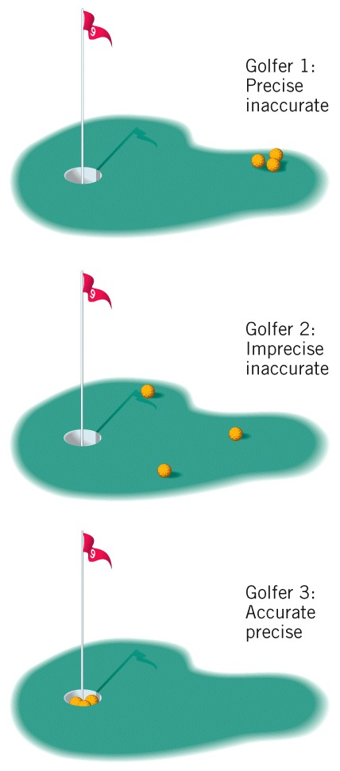
Accuracy and Precision
Accuracy
  How close measurement is to true or accepted true value
Precision
  How well set of repeated measurements of same quantity
  agree with each other
46

Slide 47
Exact Numbers
Numbers that come from definitions
  12 in. = 1 ft
  60 s = 1 min
Have no uncertainty
Exact number does not affect any calculation
47

Slide 48
Your Turn!
Express the answer to the following with the correct number of significant figures:
3 ft.
3.0 ft
3.00 ft.
3.000 ft.
3.00000 ft.
36.00 has four sig. figs. The conversion is exact.
So the answer has four
sig. figs.
48

Slide 49
Dimensional Analysis
Also called the Factor Label Method
Use units (dimensions) to analyze problem
Conversion Factor
Used to switch from one system of measurement and units to another
Given Quantity
×
Conversion Factor
=
Desired Quantity
49

Slide 50

Conversion Factors
Example: How to convert a person’s height from 68.0 in to cm?
  Start with fact
  2.54 cm = 1 in. (exact)
Will this conversion fact make any impact on SF of the result ?
50
Notes:
50

Slide 51
Dimensional Analysis
Now multiply original number by conversion factor that cancels old units and leaves new
Given Quantity
×
Conversion Factor
Desired Quantity
=
= 173 cm
51

Slide 52
Using Dimensional Analysis
Example: Convert 0.097 m to mm.
Relationship is 1 mm = 1 × 10^{–3} m
Since going from m to mm use one on left.
= 97 cm
52

Slide 53
Learning Check
Example: Convert 3.5 m³ to cm³.
Start with basic equality 1 cm = 0.01 m
Now cube both sides
  Units and numbers
  (1 cm)³ = (0.01 m)³
  1 cm³ = 1 × 10^{–6} m³
3.5 × 10⁶ cm³
53

Slide 54
Your Turn!
The volume of a basketball is 433.5 in³. Convert this to mm³.
1.101 × 10⁻² mm³
7.104 × 10⁶ mm³
7.104 × 10⁴ mm³
1.101 × 10⁴ mm³
1.101 × 10⁶ mm³
54

Slide 55
Density
Ratio of object’s mass to its volume
Units
  g/mL or g/cm³
55
Notes:
55

Slide 56
Learning Check
A student weighs a piece of gold that has a volume of 11.02 cm³ of gold. She finds the mass to be 212 g. What is the density of gold?
19.3 g/cm³
56

Slide 57
Your Turn!
Titanium is a metal used to make artificial joints. It has a density of 4.54 g/cm³. What volume will a titanium hip joint occupy if its mass is 205 g?
9.31 × 10² cm³
B. 4.51 × 10¹ cm³
C. 2.21 × 10^{–2} cm³
D. 1.07 × 10^{–3} cm³
E. 2.20 × 10^{–1} cm³
57

